Slide 1

Factors in R
Group 4

Slide 2
We will Cover:
What are Factors
How to Create a Factor
Attributes of a Factor
How to access components of a Factor
Changing the order of levels in a factor
Generating Factor Levels
How to modify Factors
Factors in a Data Frame

Slide 3

What are Factors
A Factor is a collection of values that all come from a fixed set of possible values.
- In R, factors are used to work with these categorical variables as well as displaying character vectors in a non-alphabetical order.

Slide 4
Create a Factor
Create a Vector as an input
Create a new variable and set it to apply the Factor function and pass in the vector variable
Use typeof() or is.factor() functions to check whether we have created a factor

Slide 5
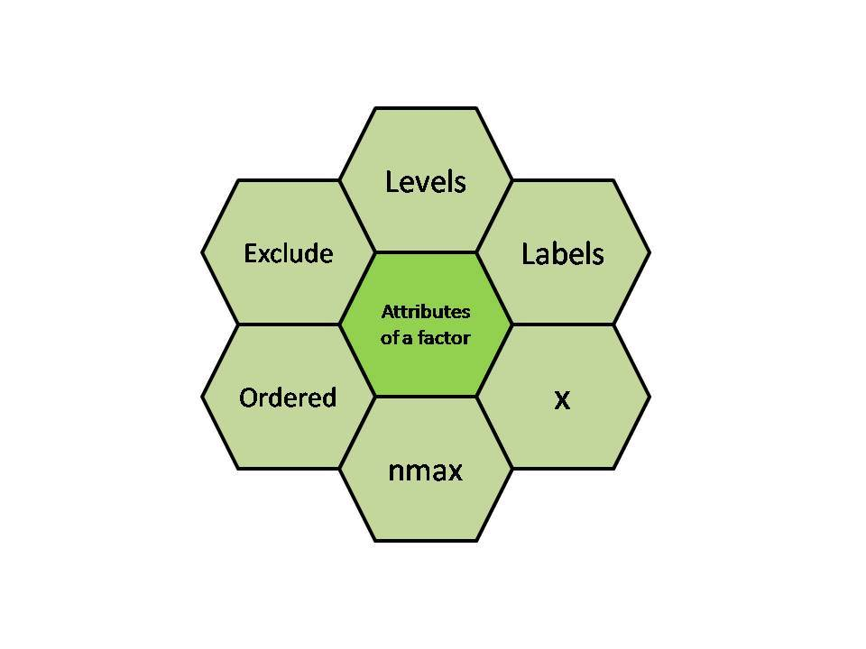
Attributes of a Factor
x - input vector which is to be transformed into a factor.
levels - input vector that represents a set of unique values which are taken by x.
labels - character vector which corresponds to the number of labels.
exclude - used to specify the value which we want to be excluded.
ordered - logical attribute which determines if the levels are ordered.
nmax - used to specify the upper bound for the maximum number of level

Slide 6
Access Components of a Factor
Components in a factor start at position one, not zero like arrays.
Access by the position of the component
Access multiple components
Access all elements except a specific one
Access all elements using a logical vector

Slide 7
Modification of a Factor
Rules:
You cannot assign values outside levels
To add a new value, you have to add a new level
Finally add your new value to the level you want

Slide 8
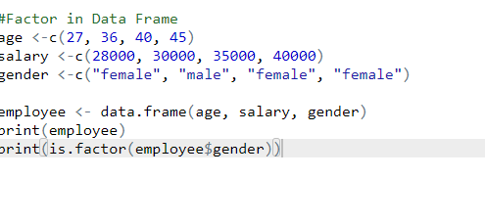
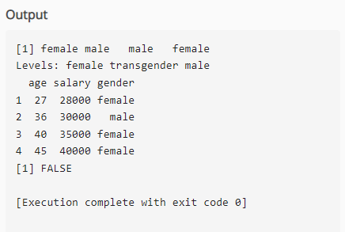
Factor in Data Frame
A Data Frame is a representation of data in a table format, i.e., using rows and columns
Only three forms of data can be contained in a data frame:
i) factor,
ii) numeric, and
iii) character type.

Slide 9
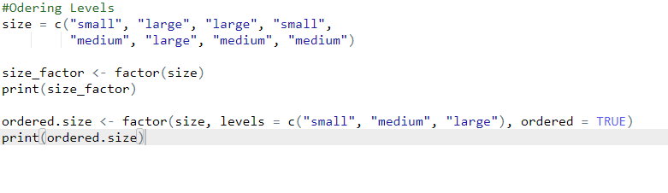
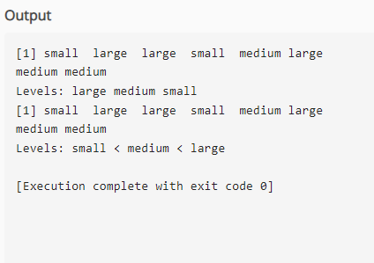
Changing order of the levels
Factors are expanded into ordered factors.
Levels are arranged in ascending order.
Two functions are used:
i) argument ordered() and
ii) factor().

Slide 10
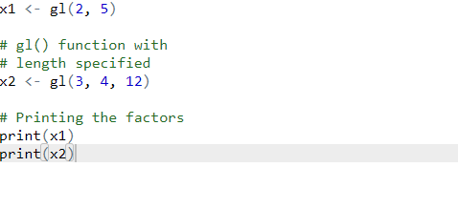
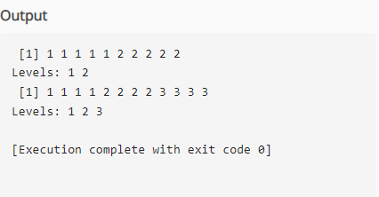
Generating Factor Levels
The R language's gl() function is used to create factors by describing the distribution of their levels.

